Slide 1
SCP – Azure Sentinel Integration
Using Azure Logic Apps
Siew Boon Siong - illumio PS

Slide 2
Objective

Slide 3
Objective
The method covers the workaround to forward the PCE system events and traffic data to the Azure Sentinel SIEM:
https://docs.illumio.com/core/21.2/Content/Guides/events-administration/events-described/list-of-event-types.htm
PCE System Events - Such as:
agent.clone_detected
agent.missed_heartbeats
agent.process_failed
pce.application_stopped
user.login_failure_count_exceeded
workload.online
workload.offline_after_ven_goodbye

Slide 4
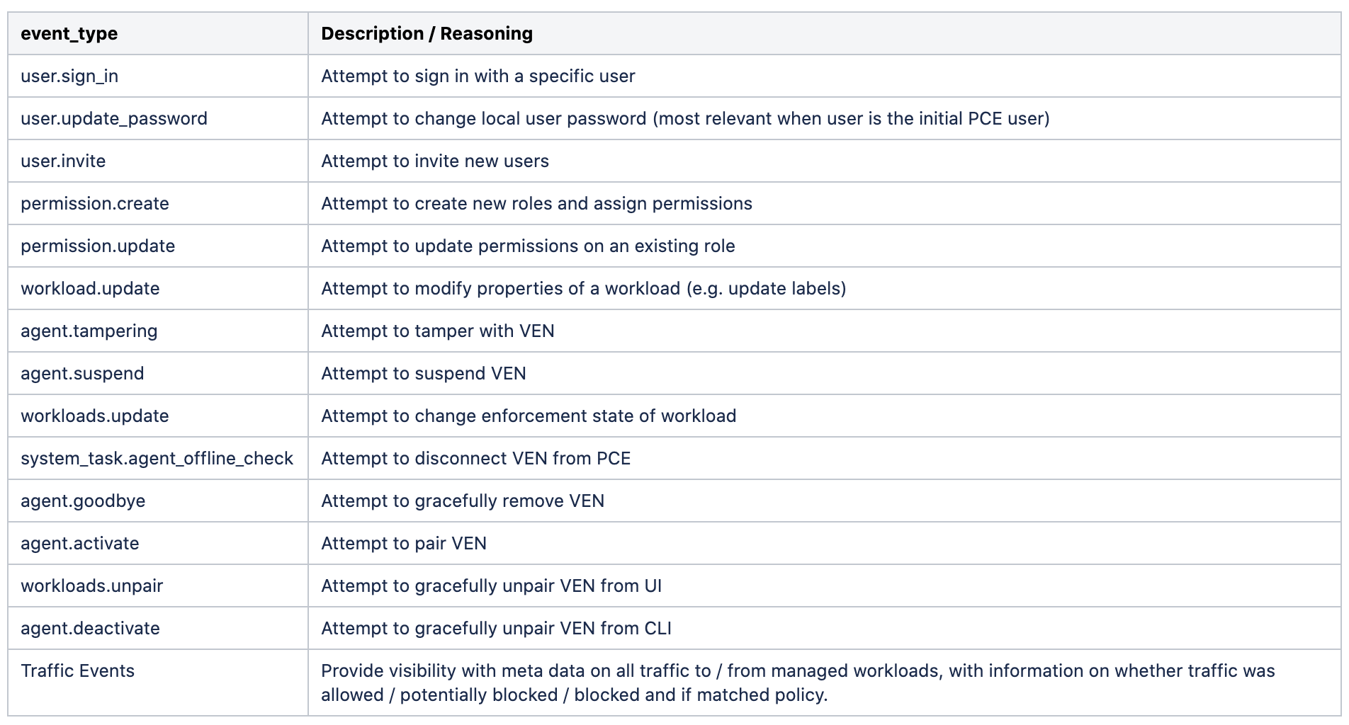
Starting Point : Events worth watching
https://docs.illumio.com/core/21.2/Content/Guides/events-administration/events-described/events-monitoring-best-practices.htm

Slide 5
Preparation – Setup Azure Log Analytics

Slide 6
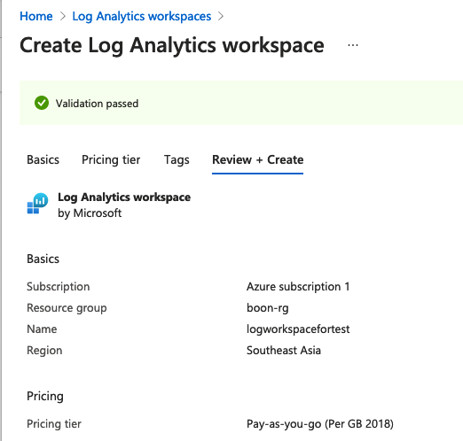
Create Azure Log Analytics Workspace
Create log analytics workspace dedicated for the logstash.
OR
You can use your existing workspace.
All we need is adding custom log table.

Slide 7
Create Custom Log – Log Analytics

Slide 8
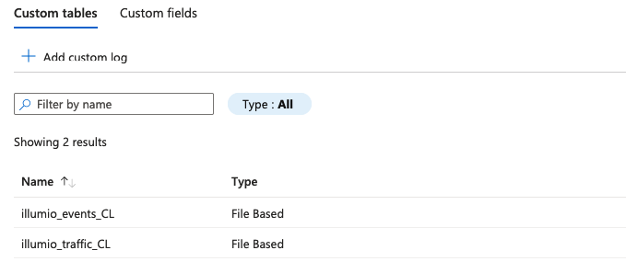
Create Custom Logs
We need to create two custom logs on the log analytics workspace.
Set two custom log name as:
”illumio_events_CL” for PCE System Event
“illumio_traffic_CL” for Traffic Data
Here’s the end result:

Slide 9
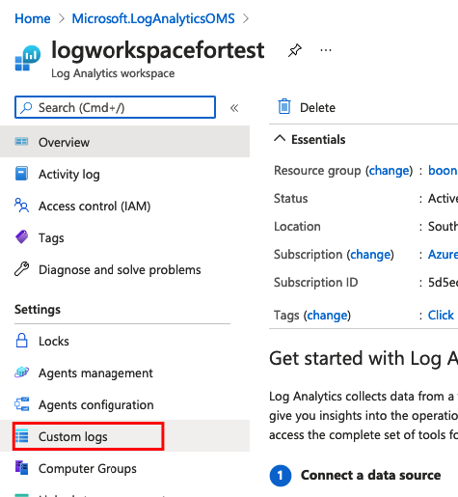
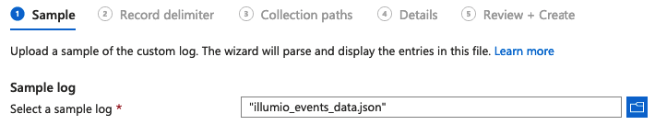
Create Custom Logs – PCE System Event
Create custom logs table.
Save the sample logs as named: “illumio_events_data.json” for initial parsing purpose:
[{"href":"/orgs/8/events/930a9027-293b-4bc0-a8b2-c3db2f83c291","timestamp":"2021-08-08T05:20:47.533Z","pce_fqdn":"scp4.illum.io","created_by":{"user":{"href":"/users/8879","username":”test@illumio.com"}},"event_type":"user.login","status":"success","severity":"info","action":{"uuid":"326e4f7a-dda0-419a-a4f7-84636831e32d","api_endpoint":"/api/v2/users/login","api_method":"GET","http_status_code":200,"src_ip":"75.1.1.1"},"resource_changes":[],"notifications":[{"uuid":"ecf7e826-a9c4-485a-9c76-6f0f8d657919","notification_type":"user.pce_session_created","info":{"user":{"href":"/users/8879","username":”test@illumio.com"}}}]}]
Upload:

Slide 10
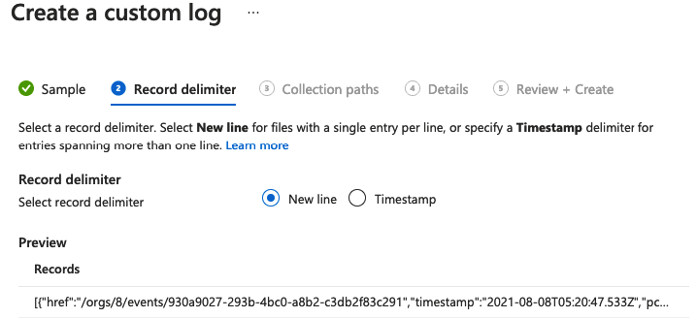
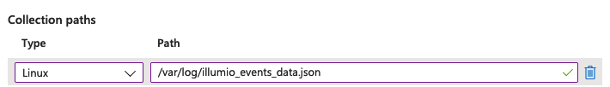
Create Custom Logs – PCE System Event (Cont.)
Select “New Line” as delimiter
Set the collection paths as /var/log/illumio_events_data.json. This is where the collection path on logstash workload.

Slide 11
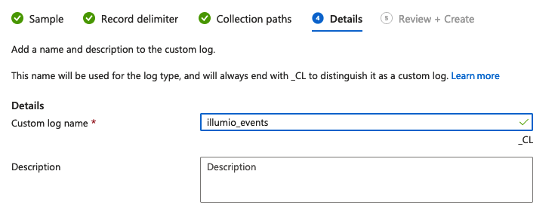
Create Custom Logs – PCE System Event (Cont.)

Slide 12
Create Custom Log – Traffic Data

Slide 13
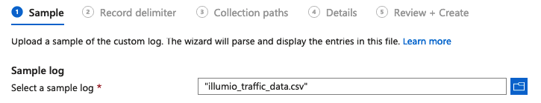
Create Custom Logs – Traffic Data
Create custom logs table.
Save the sample logs as named: “illumio_traffic_data.csv” for initial parsing purpose:
Consumer IP,Consumer IPList,Consumer Name,Consumer Hostname,Consumer Role,Consumer App,Consumer Env,Consumer Loc,Consuming Process,Consuming Service,Consuming Hostname,Provider IP,Provider IPList,Provider Name,Provider Hostname,Provider Role,Provider App,Provider Env,Provider Loc,Provider FQDN,Transmission,Port,Protocol,Providing Process,Providing Service,Providing Username,Num Flows,Connection State,Reported Policy Decision,Reported by,First Detected,Last Detected
172.16.3.100,,v19.illumioeval.com,v19.illumioeval.com,100,200,DEV,100,,,root,172.16.3.123,IPL-RFC_1918; anytest; test234,,,,,,,,Unicast,8142,TCP,,,,422,Timed Out,Potentially Blocked,Consumer,2021-08-14T00:09:18Z,2021-08-14T04:19:38Z
172.16.3.100,,v19.illumioeval.com,v19.illumioeval.com,100,200,DEV,100,,,root,172.16.3.123,IPL-RFC_1918; anytest; test234,,,,,,,,Unicast,8142,TCP,,,,89,Active,Potentially Blocked,Consumer,2021-08-14T00:04:42Z,2021-08-14T04:14:43Z
Upload:

Slide 14
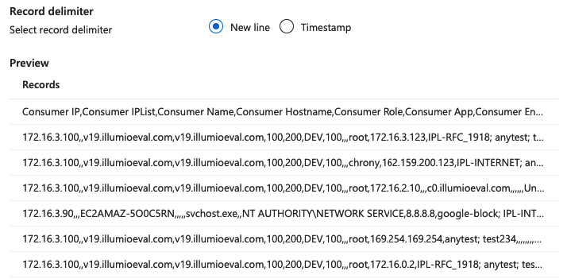
Create Custom Logs – Traffic Data (Cont.)
Select “New Line” as delimiter
Set the collection paths as /var/log/illumio_events_data.json. This is where the collection path on logstash workload.

Slide 15
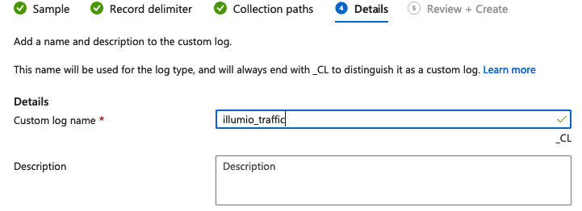
Create Custom Logs – Traffic Data (Cont.)

Slide 16
Create Azure Logic Apps

Slide 17
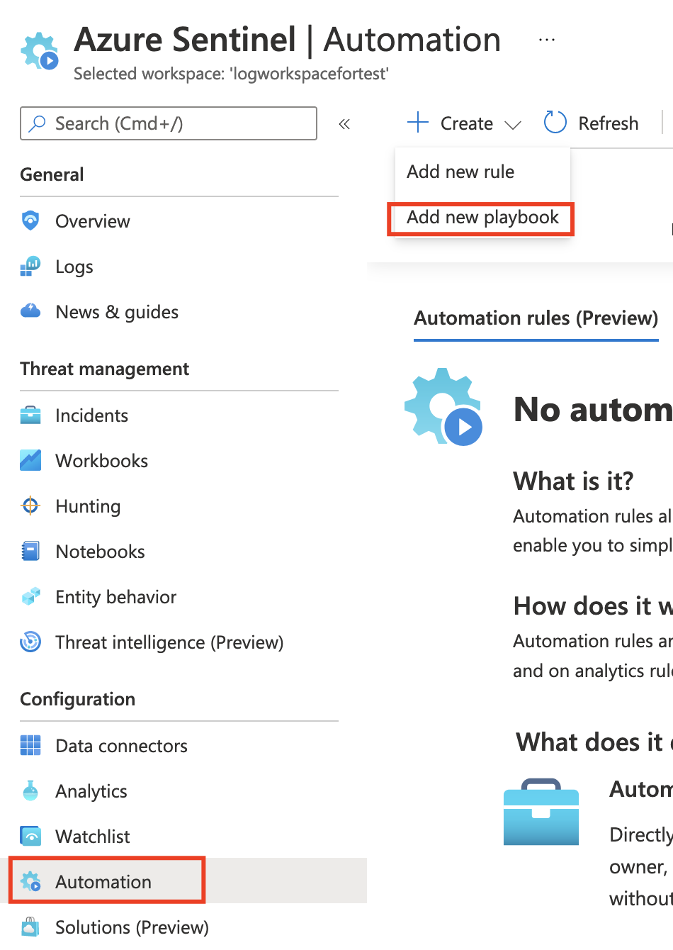
Create Azure Logic Apps
Go to:
Azure Sentinel > Configuration > Automation
Then, Create > Add New Playbook

Slide 18
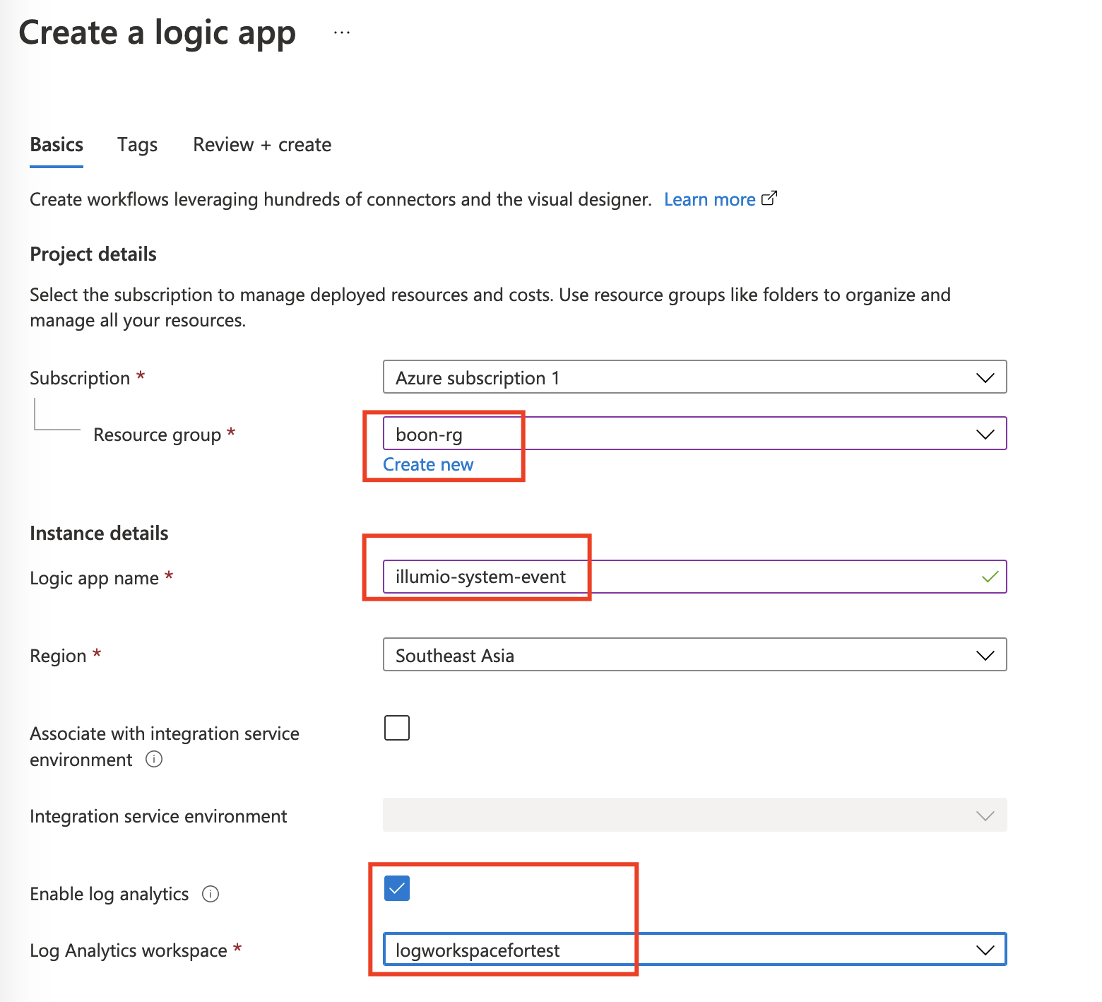
Create Azure Logic Apps
Choose your resource group
Give the app a name.
Eg: “illumio-system-event”
Eg: “illumio-traffic-data”
We need to create two apps anyway.
Enable log analytics and choose your
Log Analytics workspace.

Slide 19
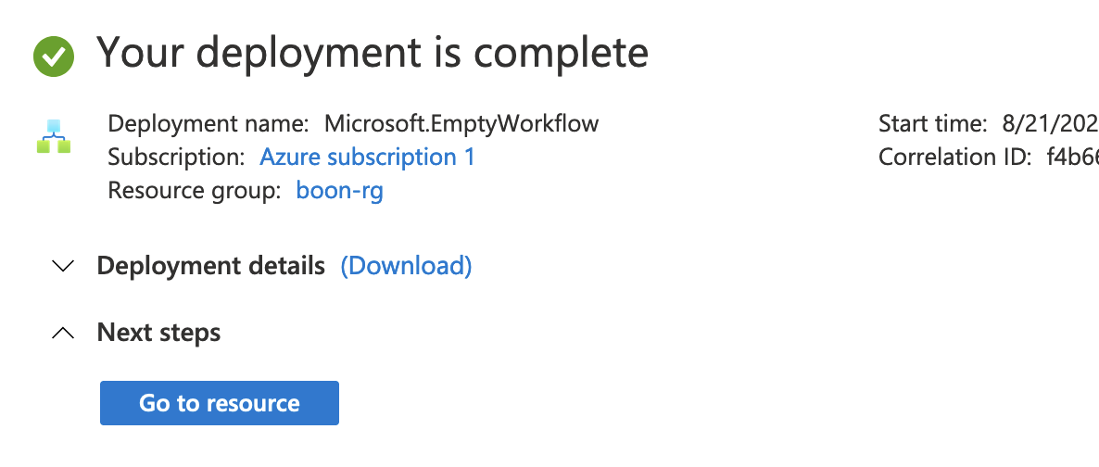
Create Azure Logic Apps
Once it is ready, you should see the completion page.
Click “Go to resource” for the next steps.
Repeat the same steps to create another logic apps.

Slide 20
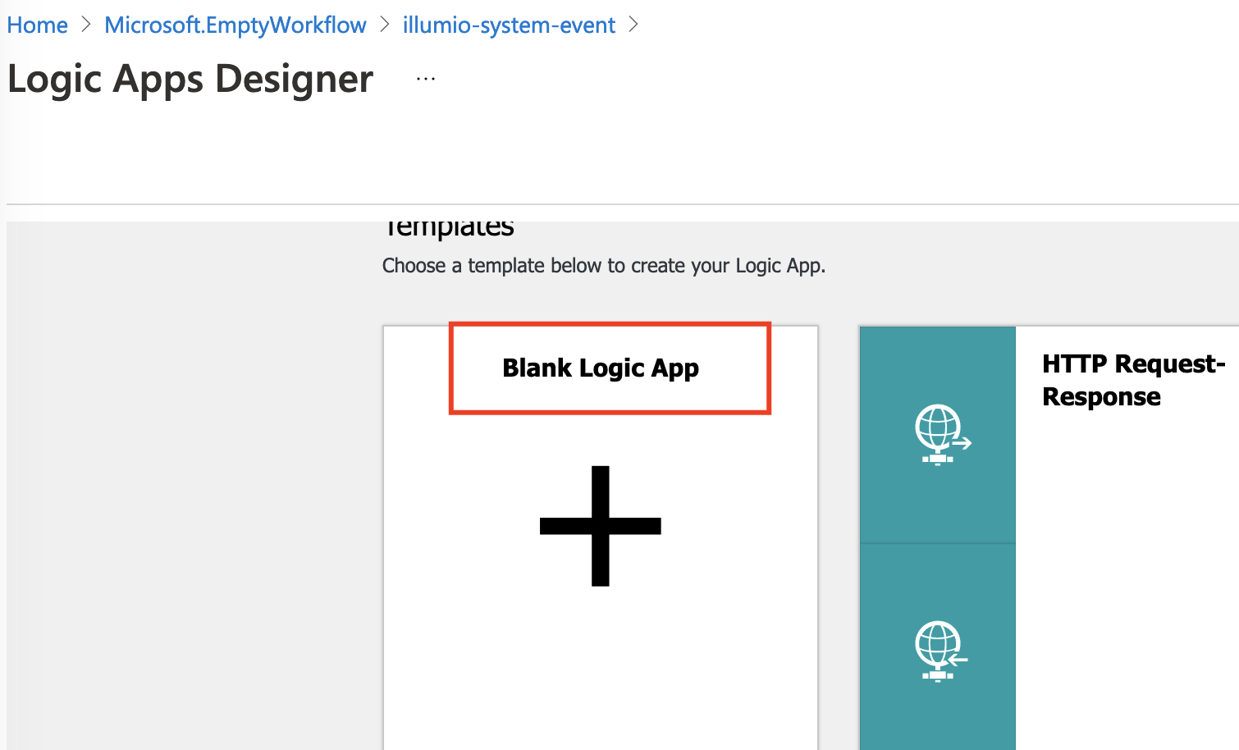
Create Azure Logic Apps
Always choose the “Blank Logic App”. Remember to repeat the same for traffic data logic apps creation.

Slide 21
Create PCE System Event Logic Apps

Slide 22
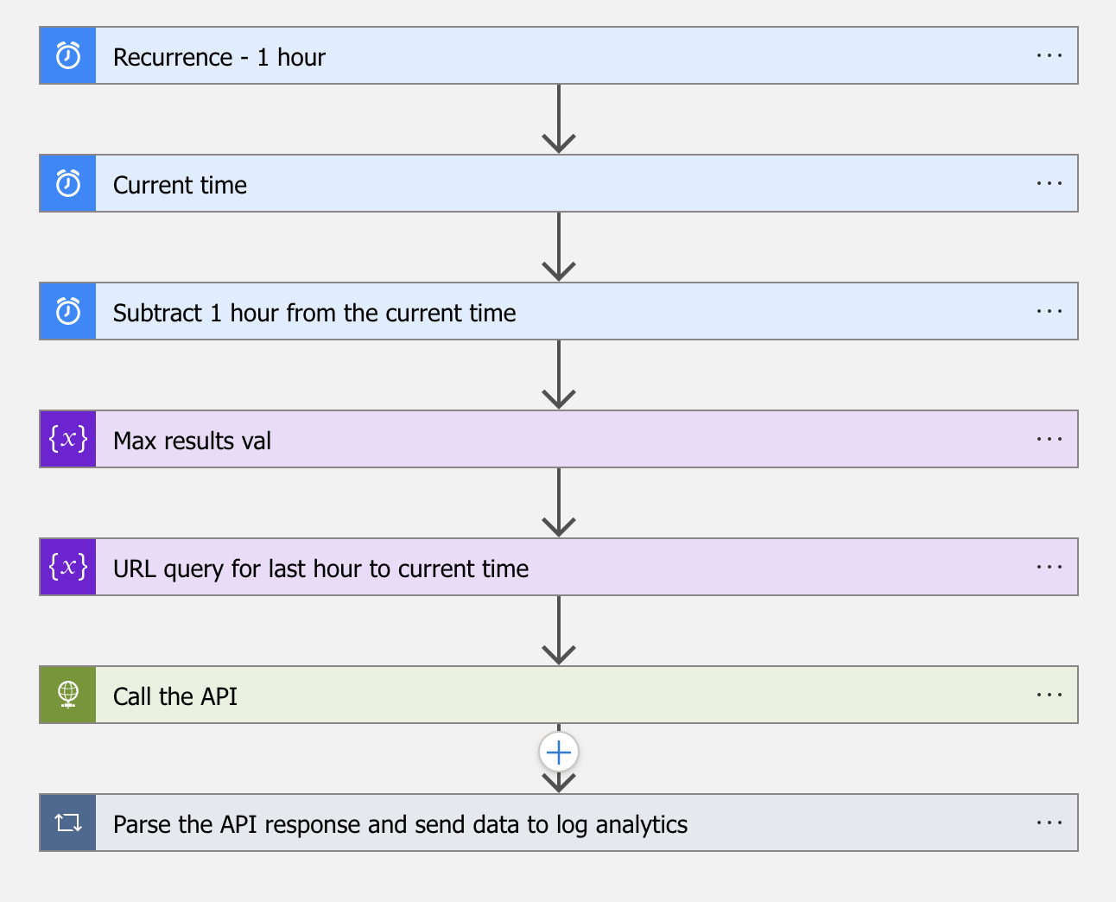
Workflow in General
Job recurrence every 1 hour
Retrieve the current time as initial variable
Subtract 1 hour from the current time variable.
Feed the variable to “timestamp[gte]=“ parameter,
So that we could always retrieve the “last hour to now”
PCE system events.
Limit the number of returned events as 1000.
Prepare the query:
/api/v2/orgs/<id>/events?max_results=1000&timesta
mp[gte]=<last hour to now>
Trigger the API call
Loop each events for parsing the JSON schema
correctly, and send data to log analytics.
** For schema, please check the attached “illumio_systemevent_schema"

Slide 23
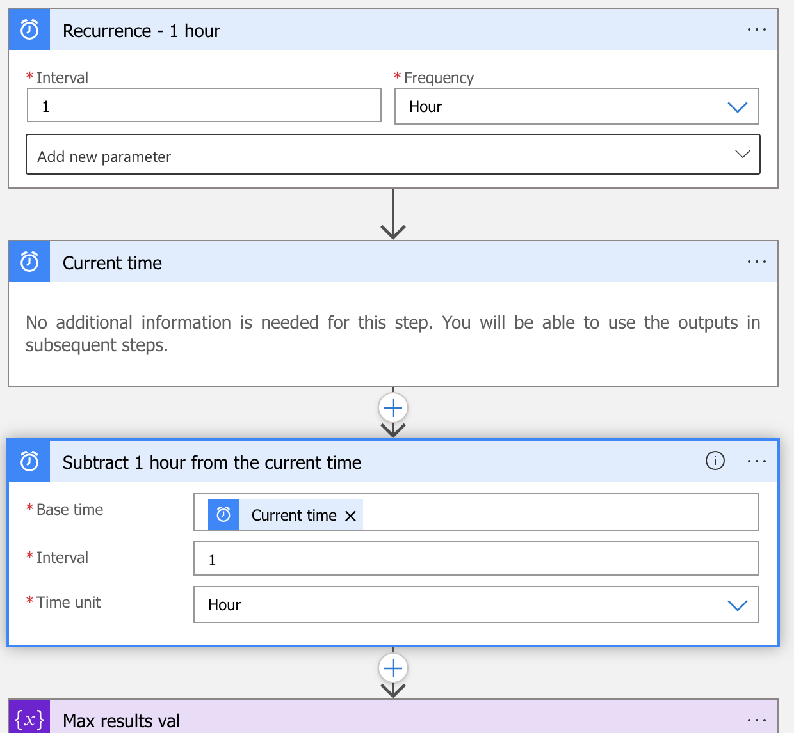
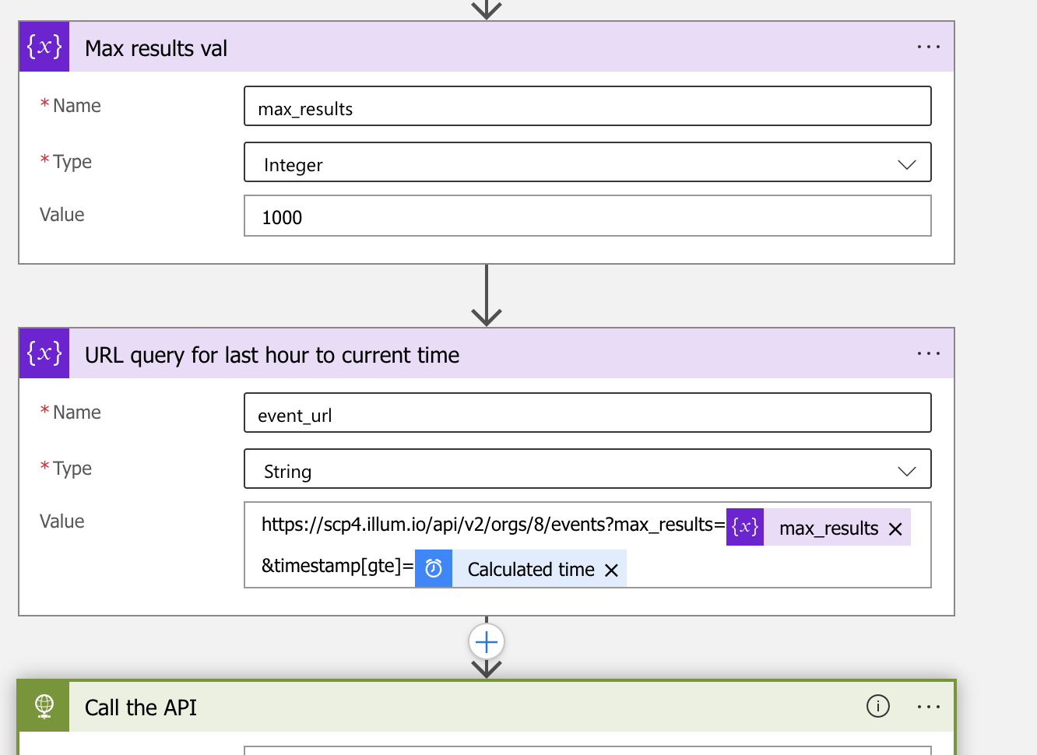
Detail for Each Flows

Slide 24
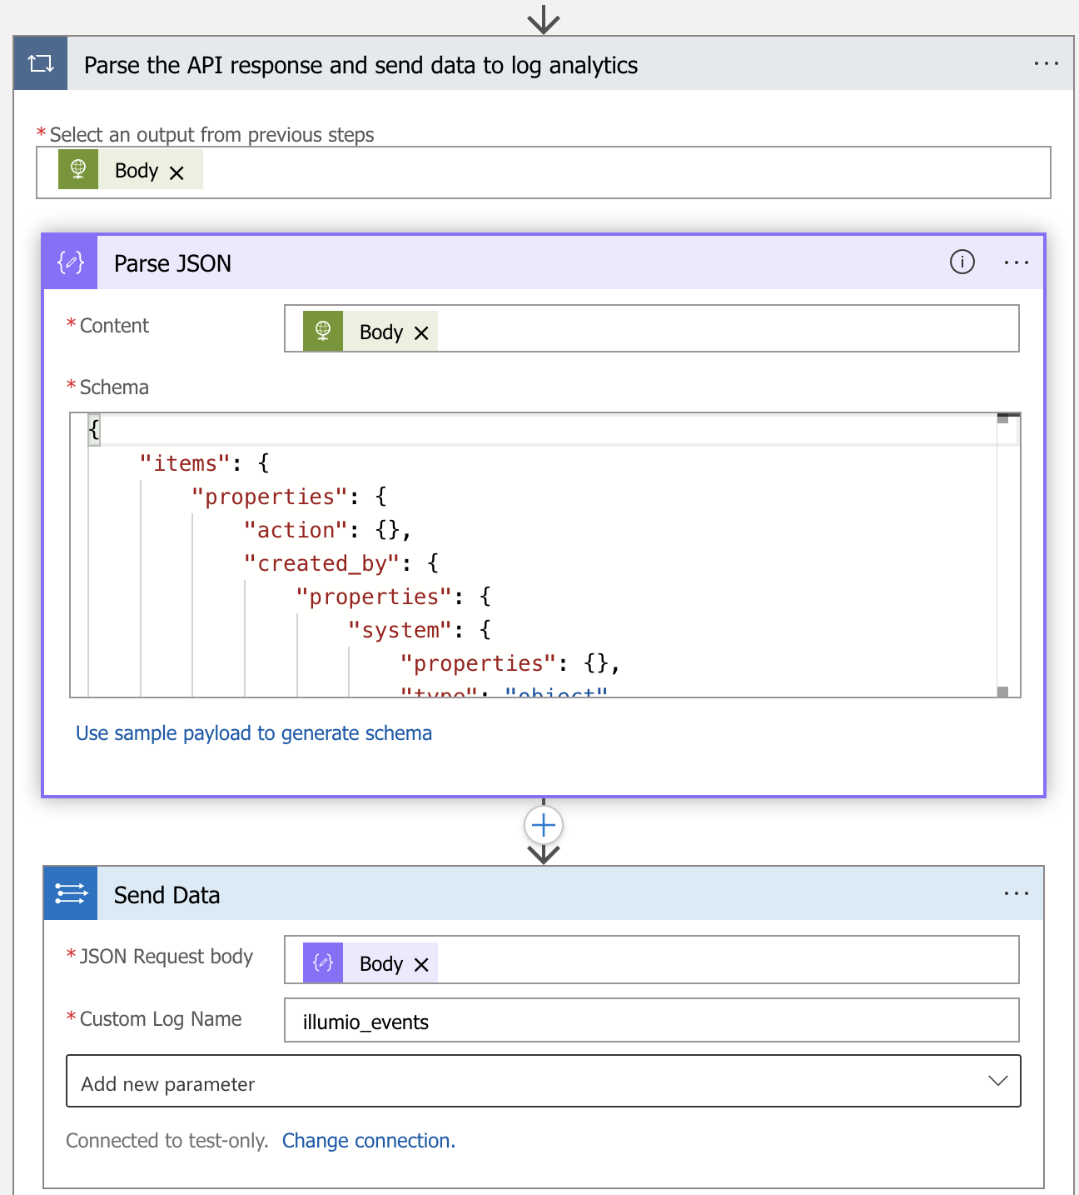
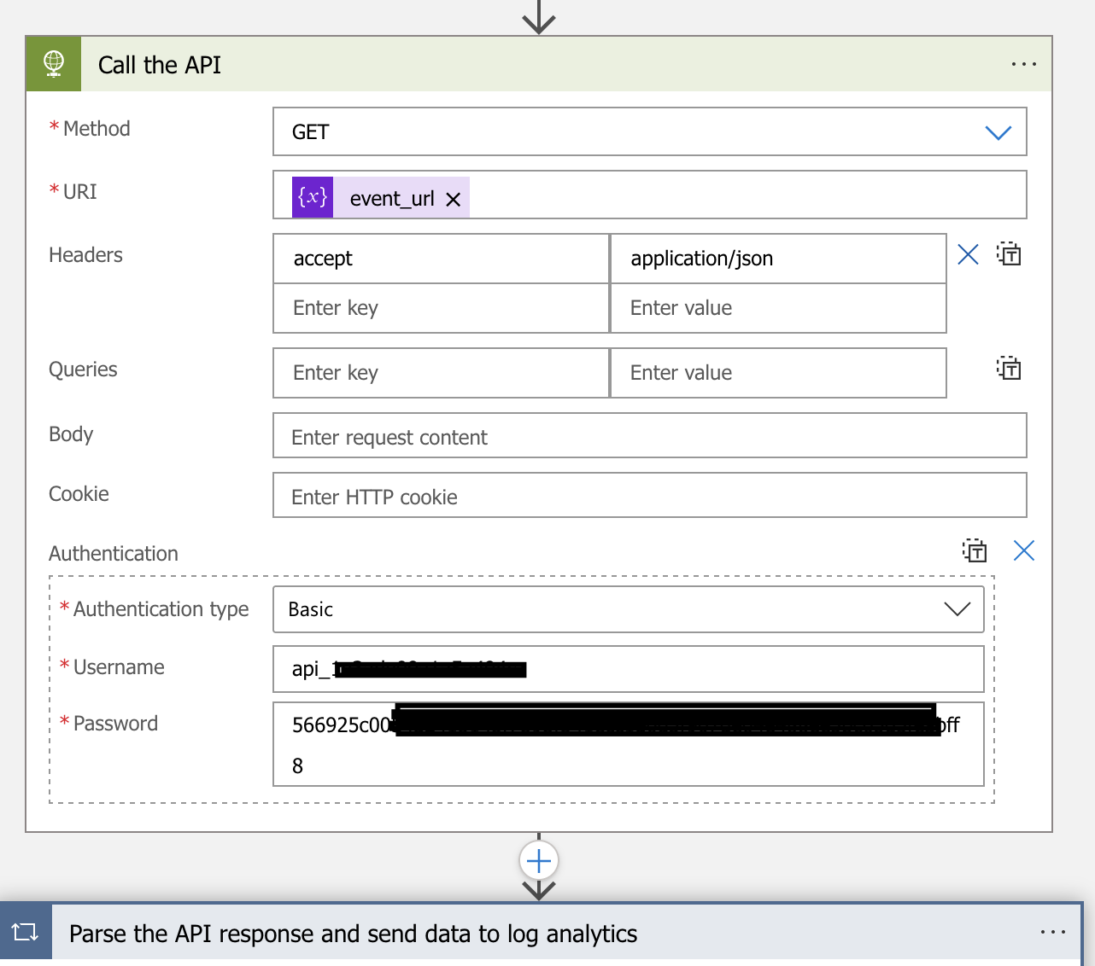
Detail for Each Flows (Cont.)

Slide 25
Create Traffic Data Logic Apps

Slide 26
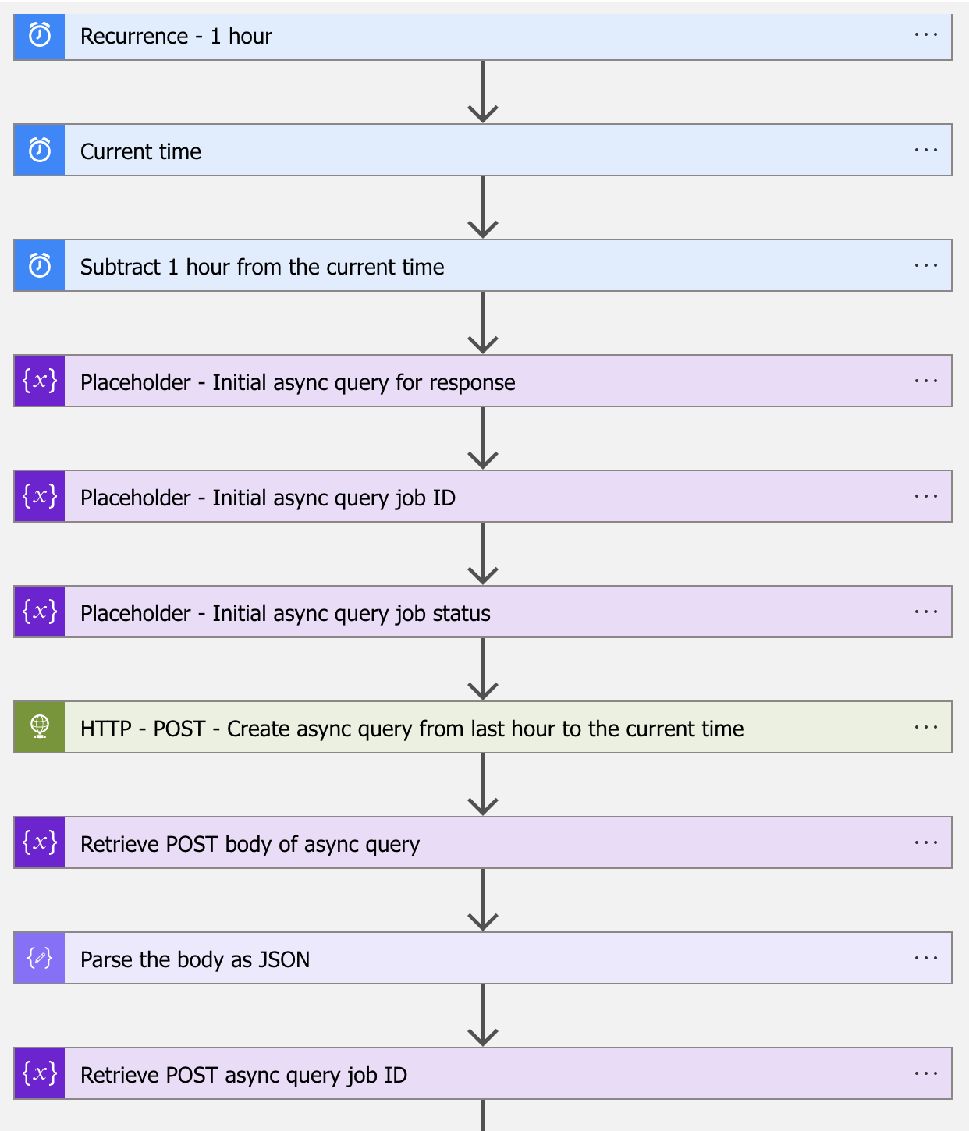
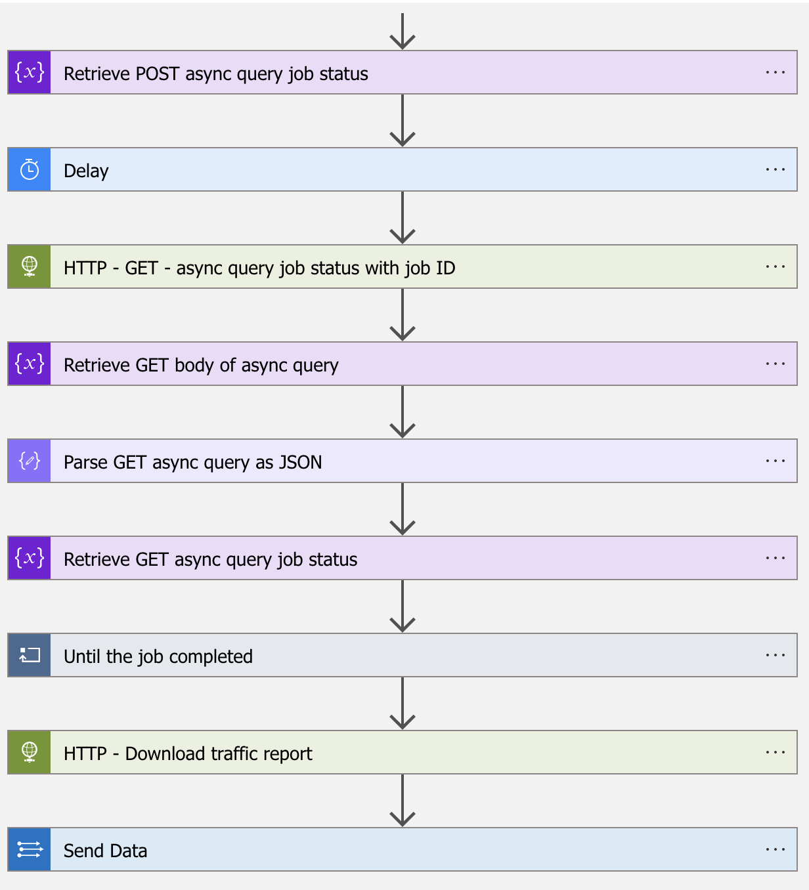
Workflow in General

Slide 27
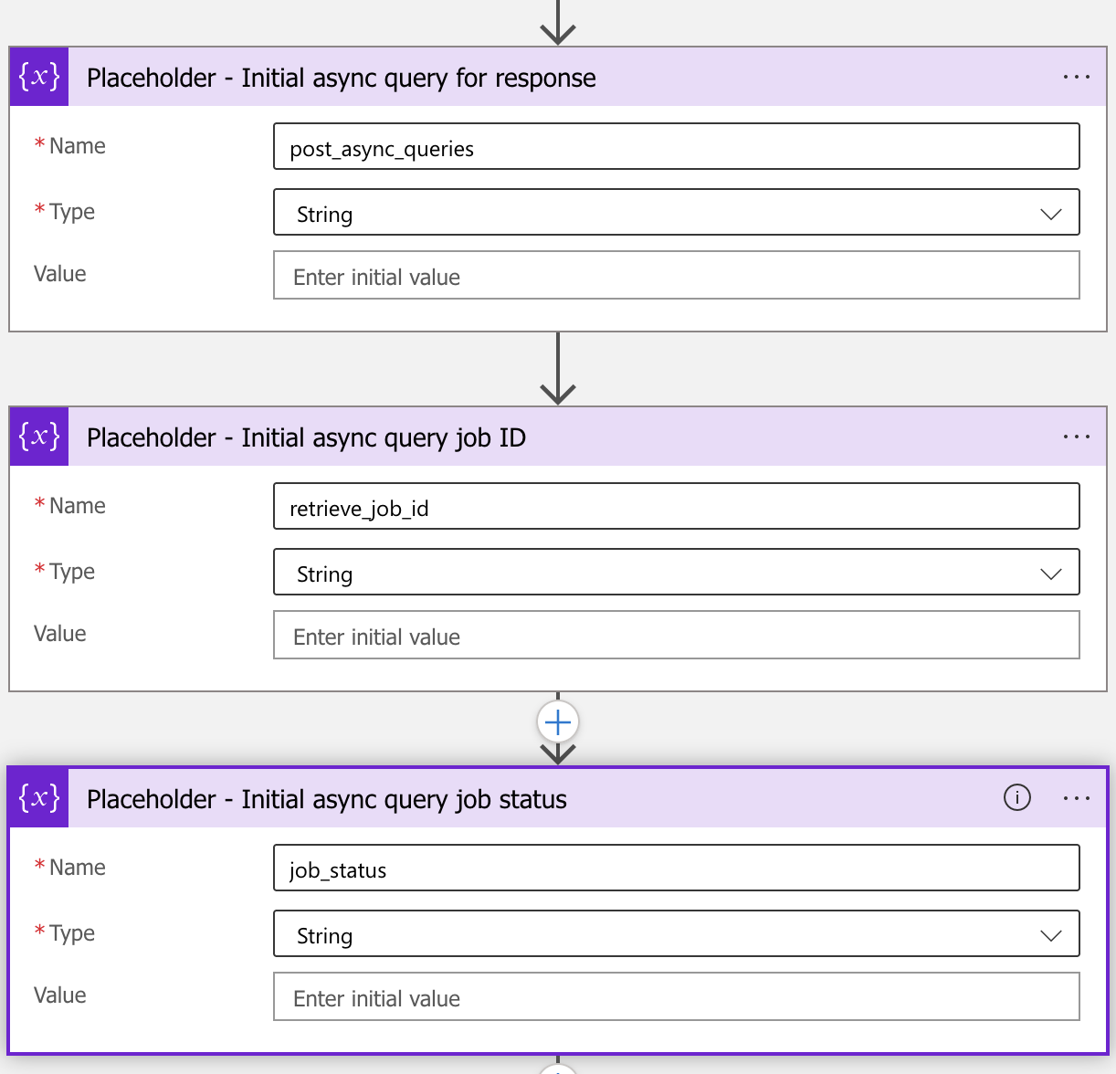
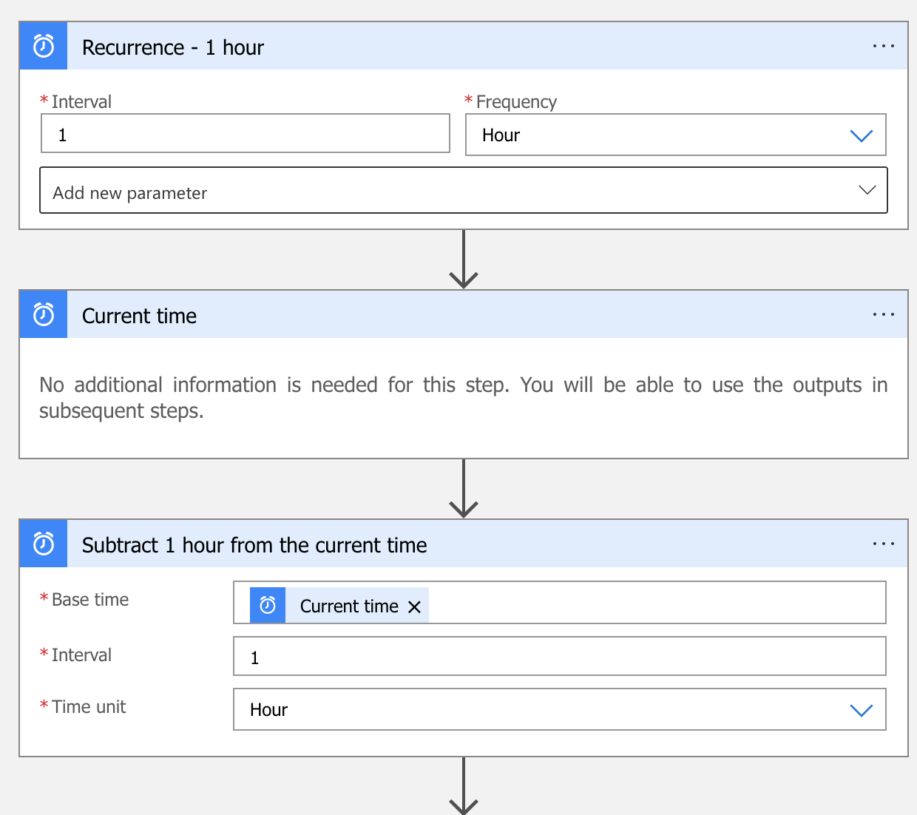
Workflow in General

Slide 28
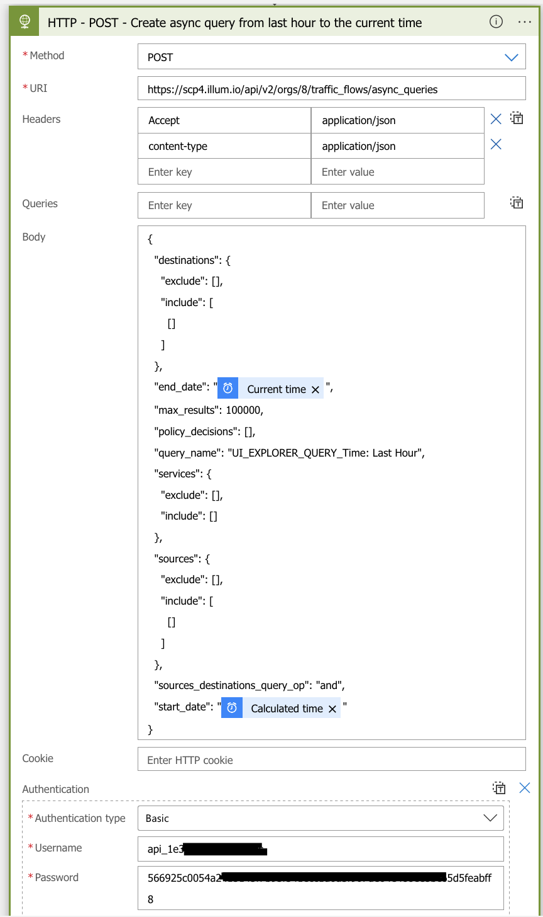
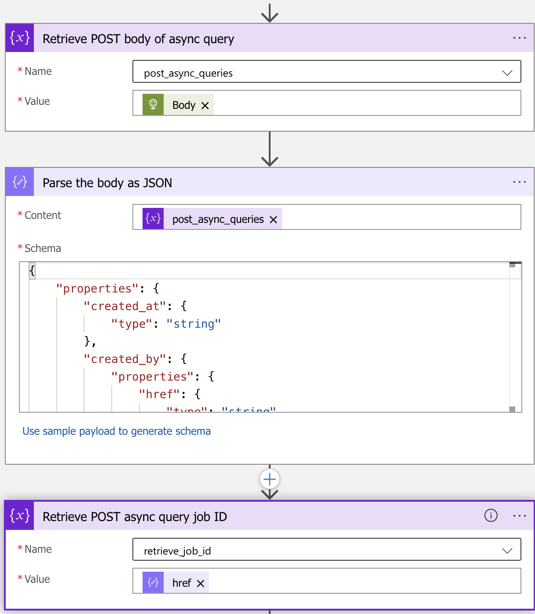
Workflow in General

Slide 29
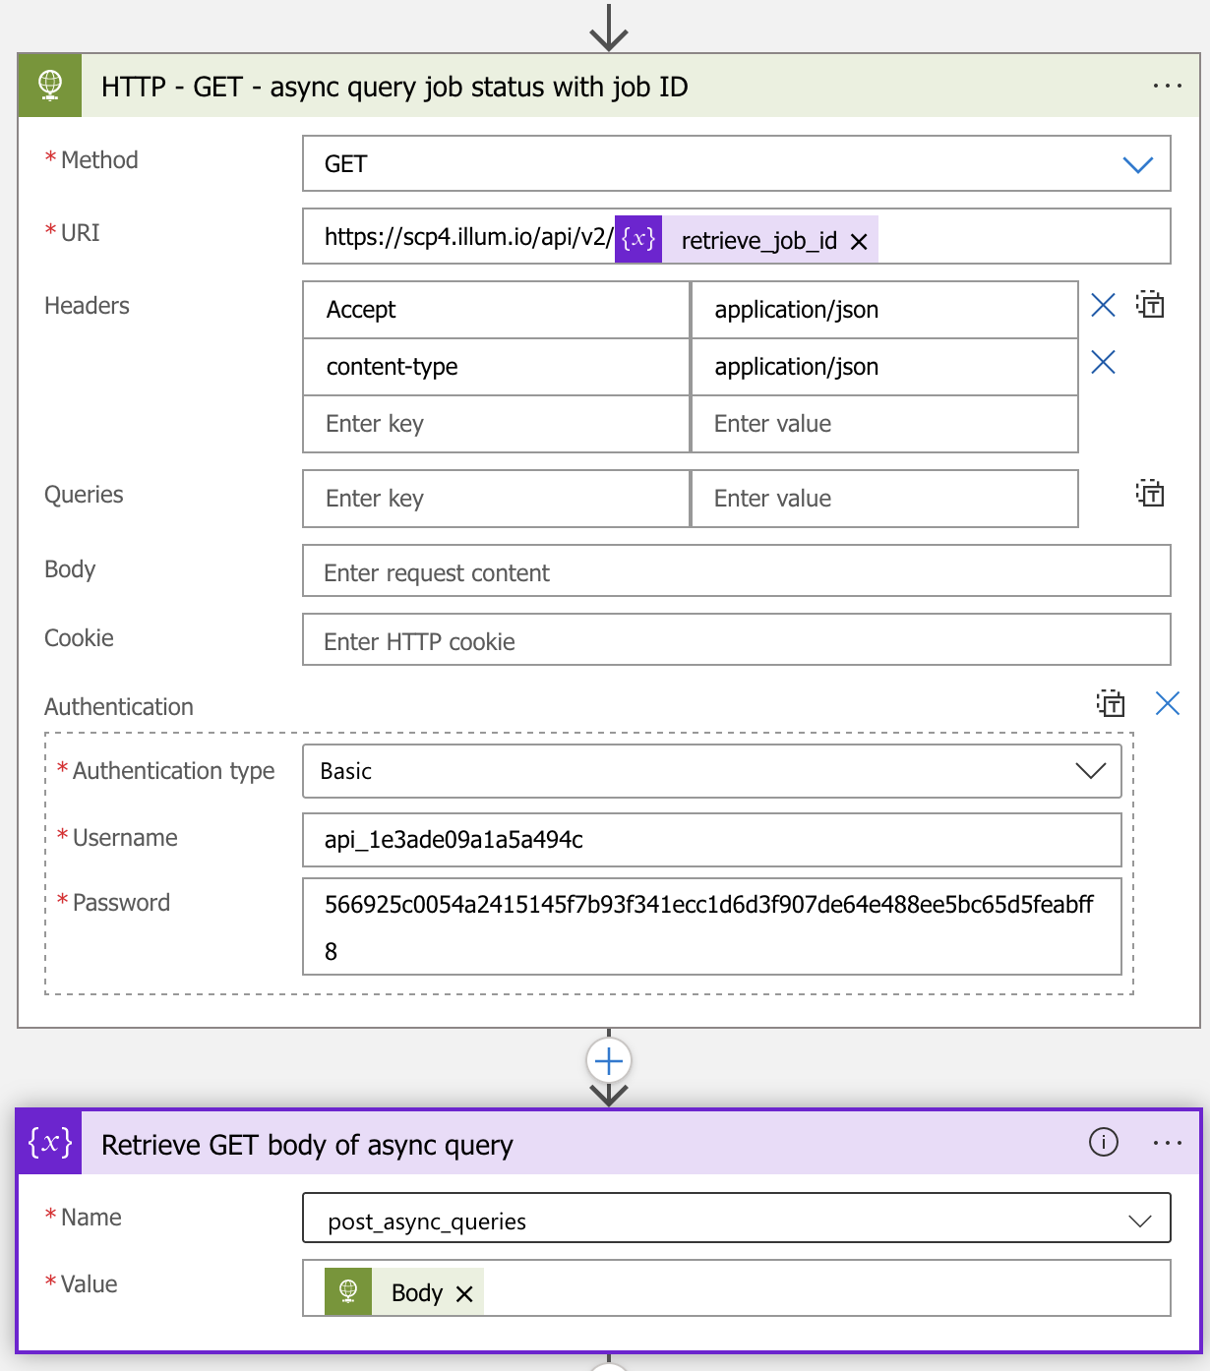
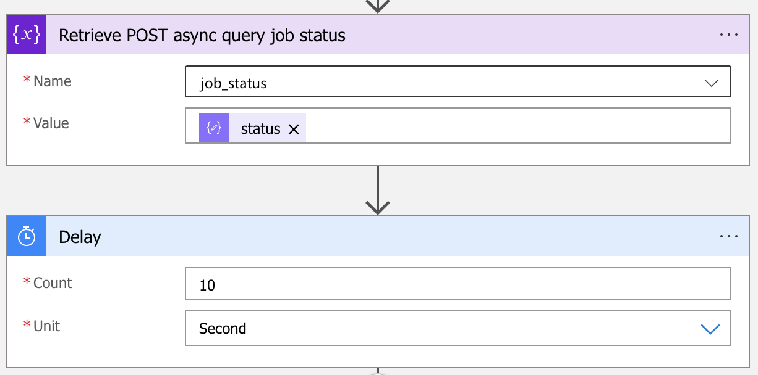
Workflow in General

Slide 30
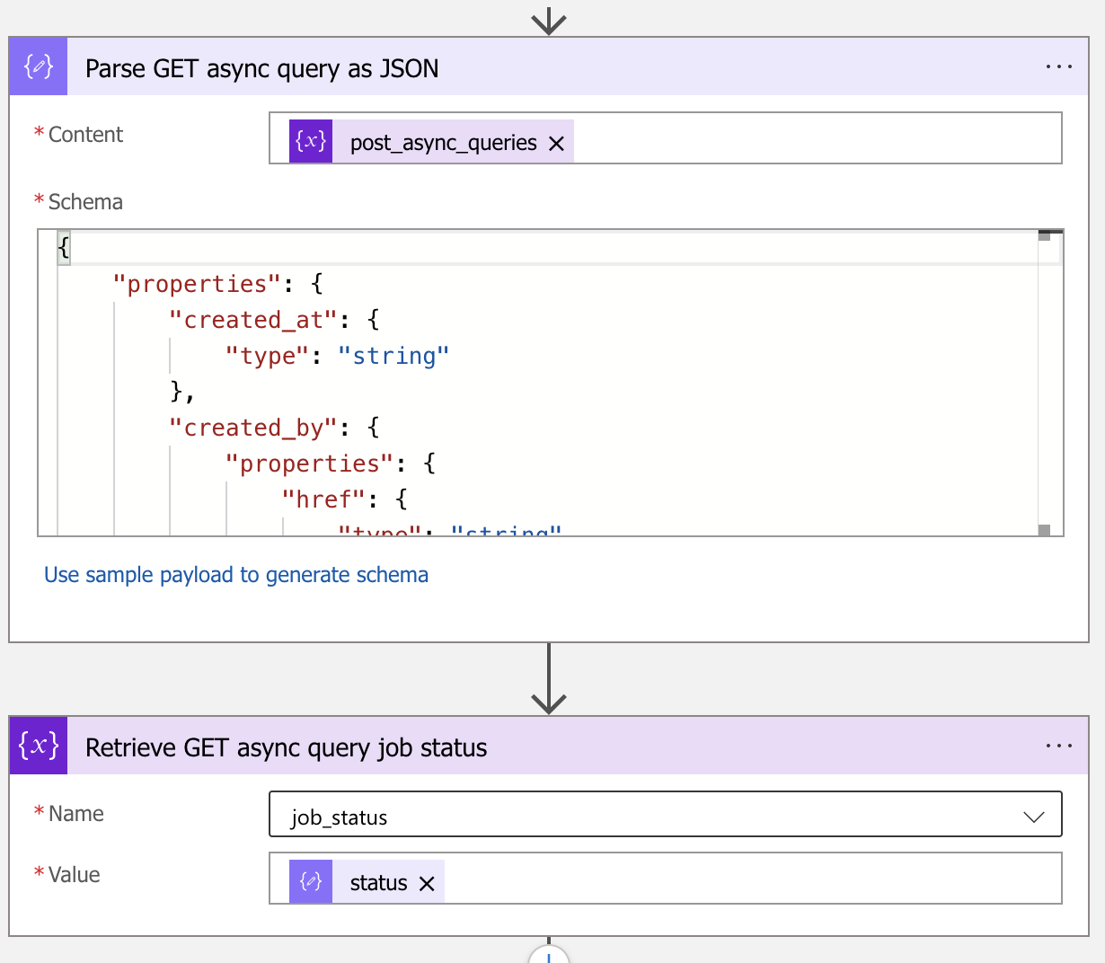
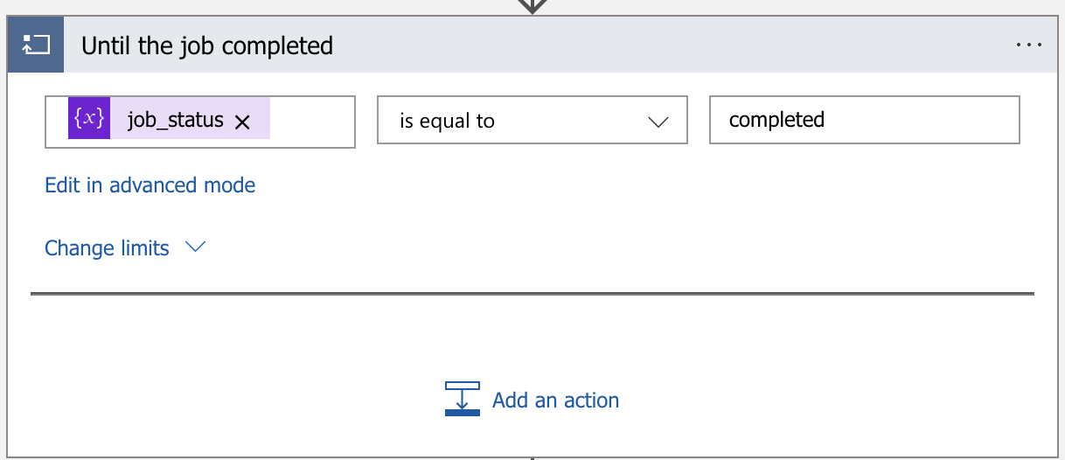
Workflow in General

Slide 31
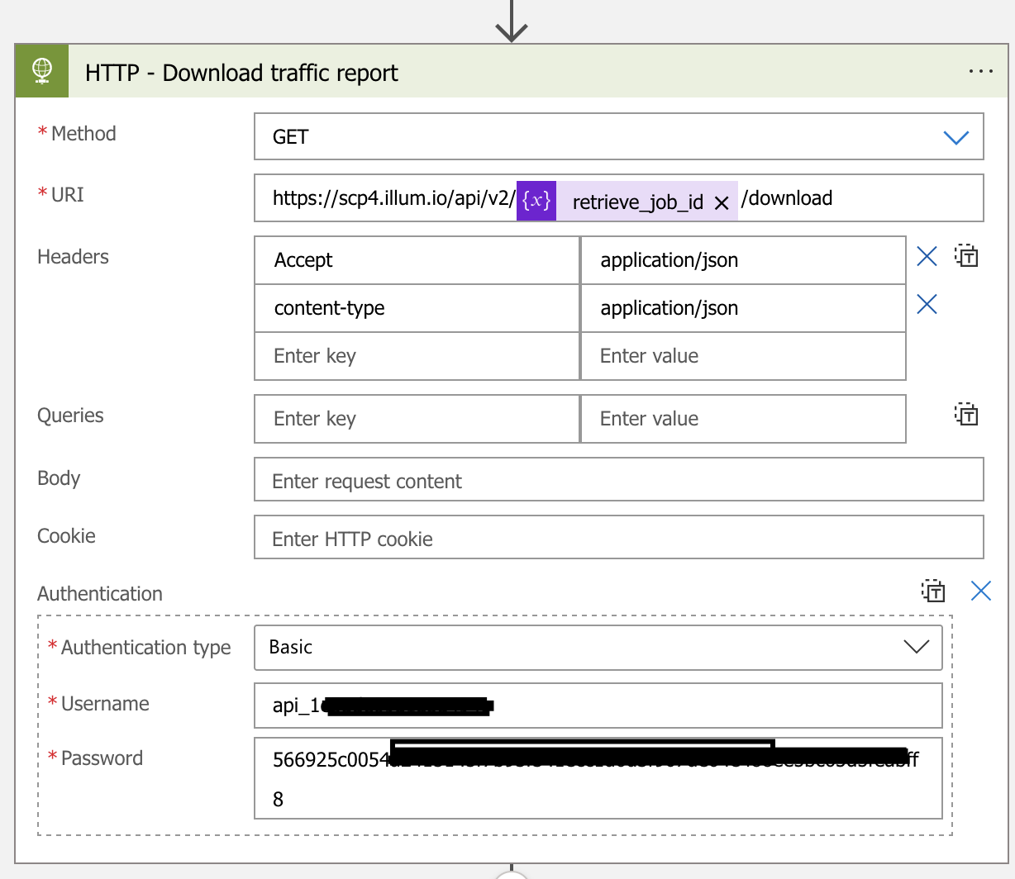
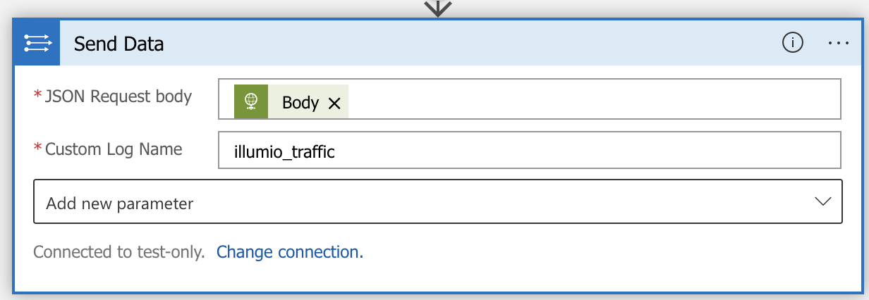
Workflow in General

Slide 32
Workflow in General
Job recurrence every 1 hour
Retrieve the current time as initial variable.
Subtract 1 hour from the current time. Use the variable to feed the “start_date” as ”last hour from now”, and the “end_data” as “current time” in the HTTP POST query to async_queries for job creation on URL: “/api/v2/orgs/<id>/traffic_flows/async_queries”.
When HTTP POST status_code=202, parse the response body as JSON properly. With this, it allows the apps to retrieve the async_query job HREF and initial async_query job status for tracking purpose.
Configure a delay timer for 10 seconds.
HTTP GET from the URL of job HREF. Eg: “api/v2/orgs/8/traffic_flows/async_queries/<job href>”
** For schema, please check the attached “illumio_systemevent_schema"

Slide 33
Workflow in General (Cont.)
When the GET status_code = 200, retrieve the response body, parse it as JSON properly.
Retrieve the job status properties from the JSON output for tracking purpose.
Monitoring the job status properties until it is equal to “completed”.
Download the traffic report from URL. Eg. “api/v2/orgs/8/traffic_flows/async_queries/<job HRF>/download”
Send data to log analytics.
** For schema, please check the attached “illumio_trafficdata_schema"

Slide 34
Verification

Slide 35
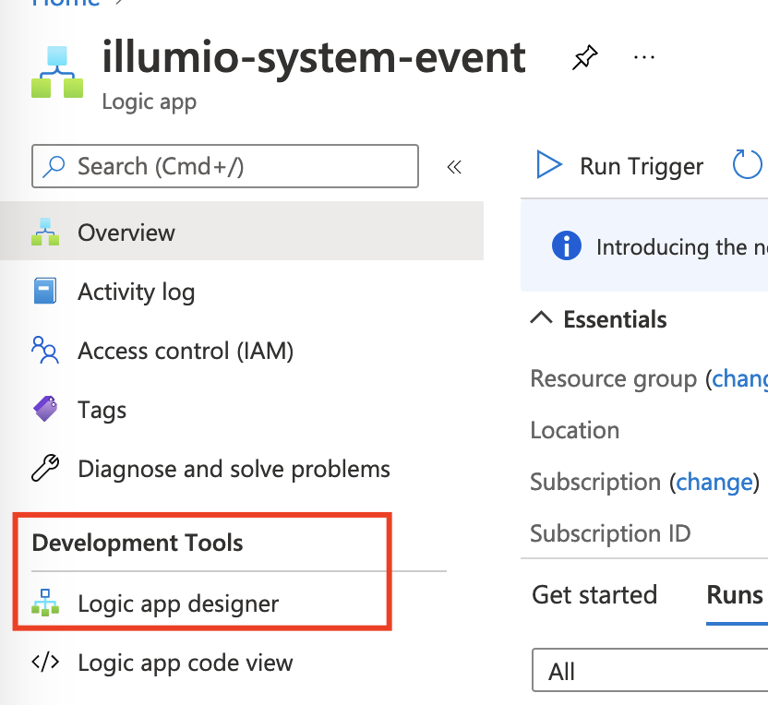
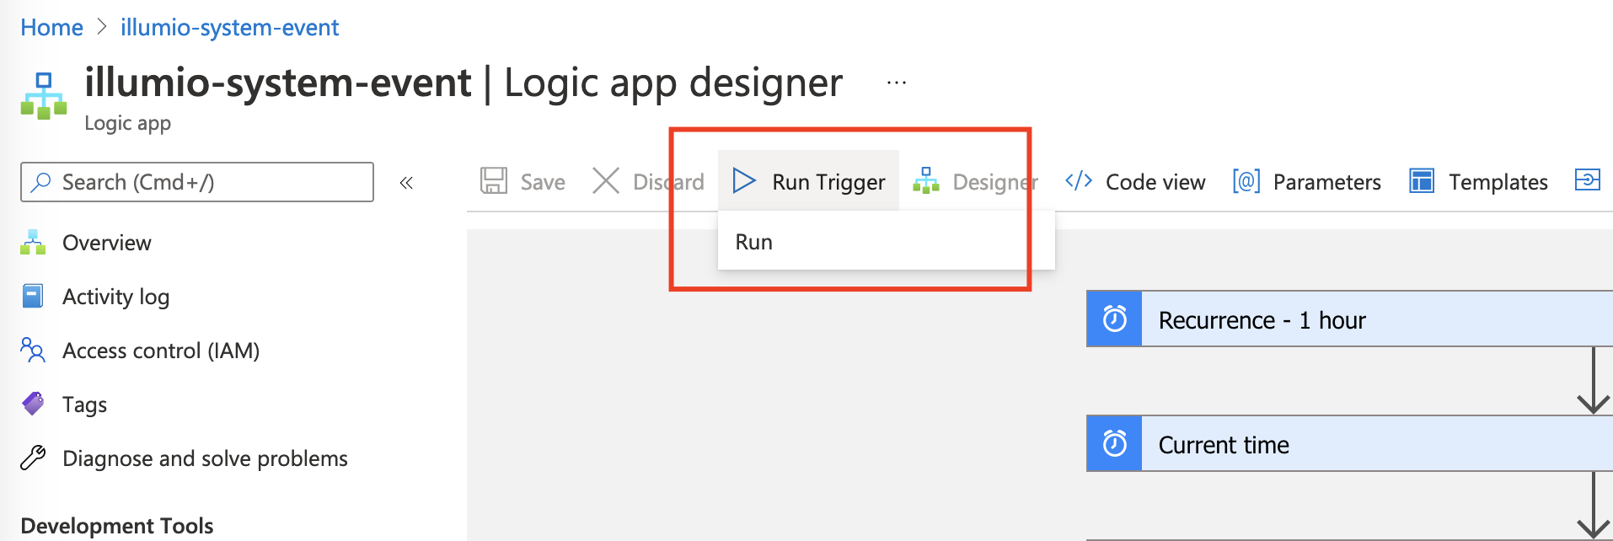
Verification
Go to the Logic Apps, click on the “Run Trigger” under “Development Tools > Logic App designer”.

Slide 36
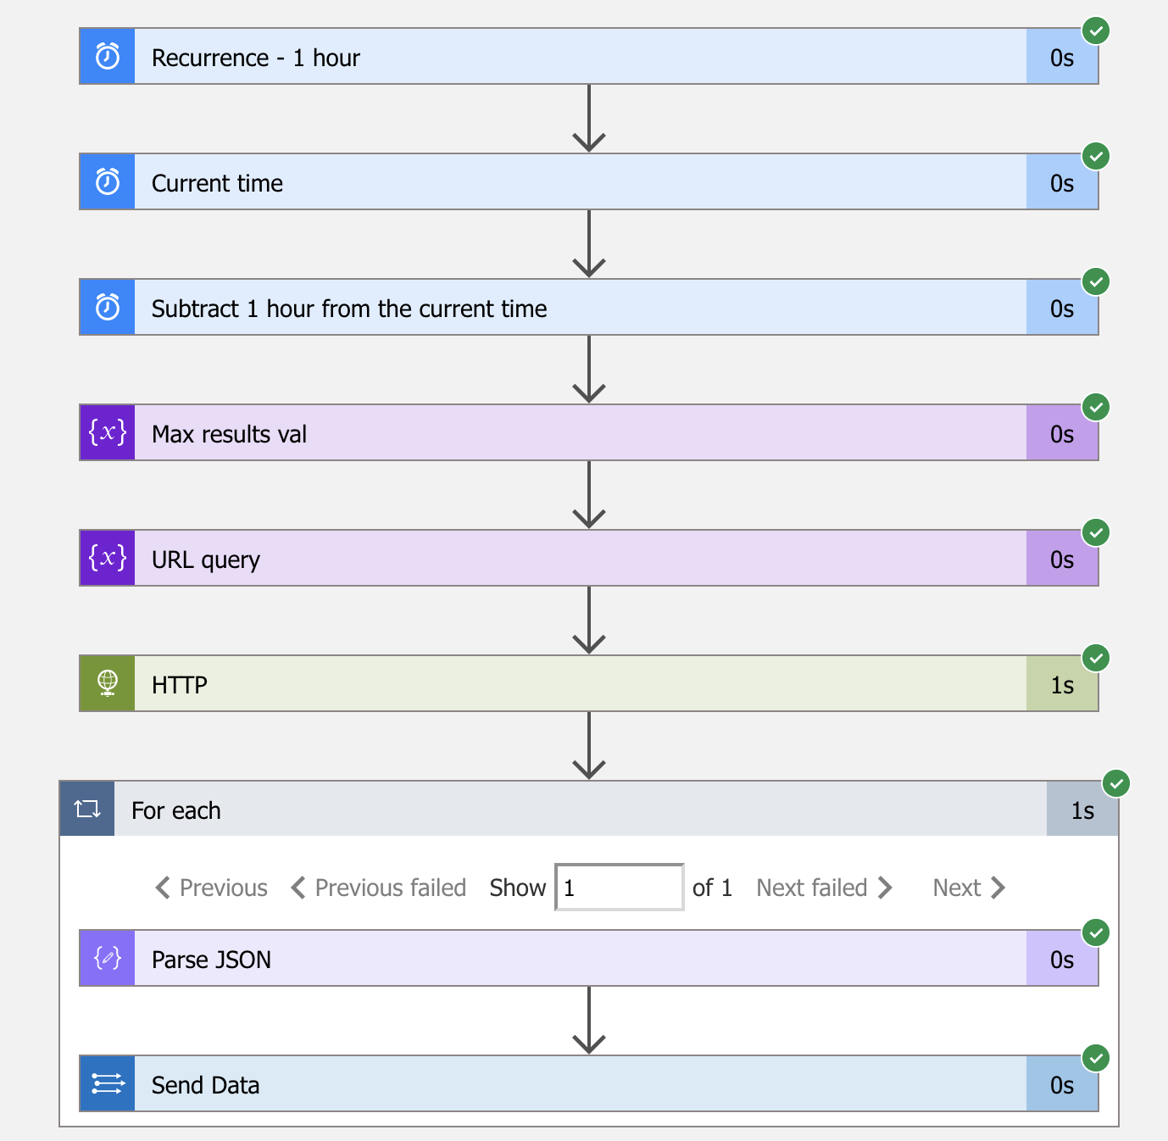
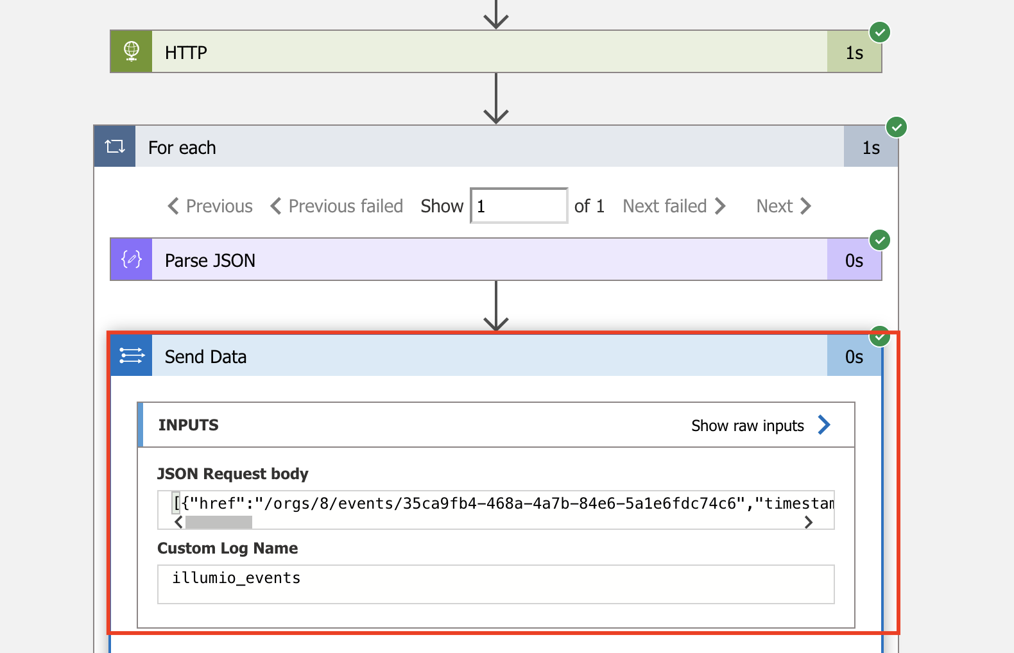
Verification
One the job triggered, you should see “Green Tick” at least, able to zoom into each flows for inspection.

Slide 37
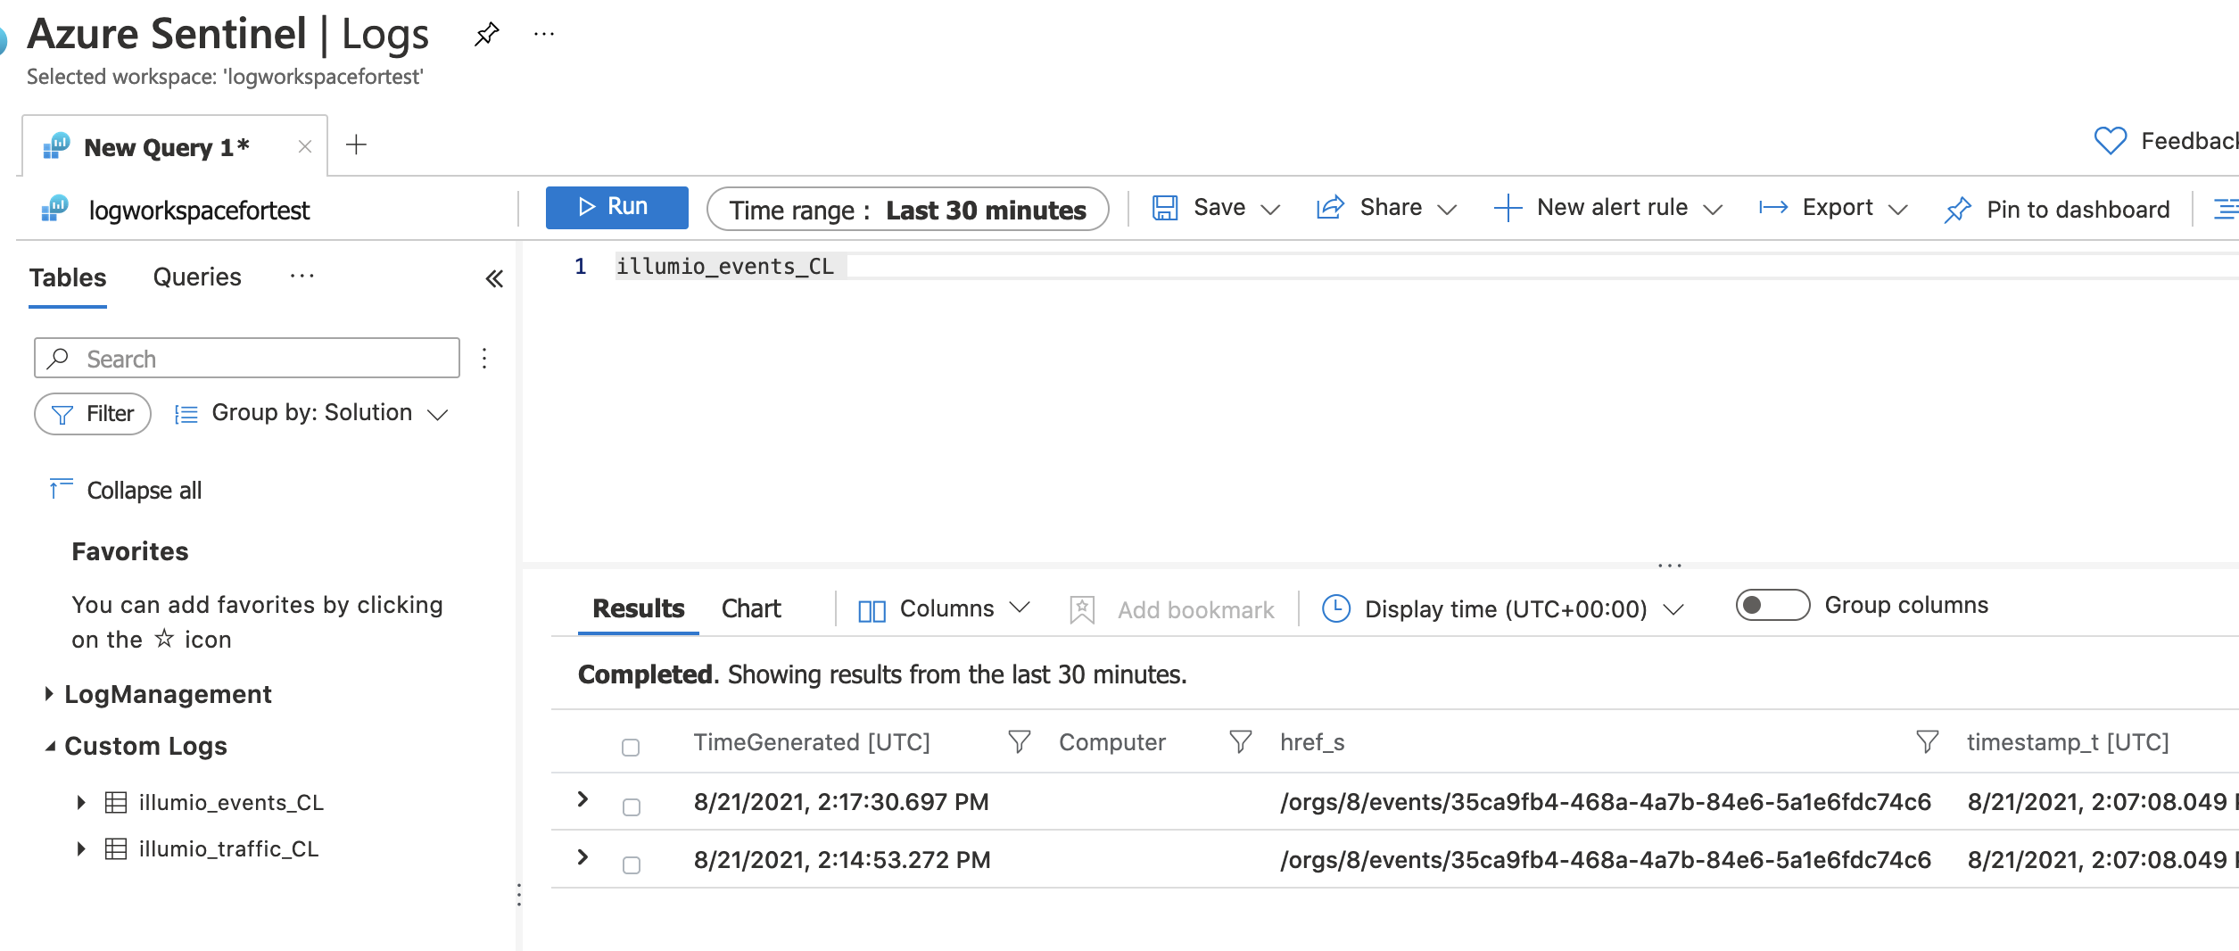
Verification
Verify on Azure Sentinel Custom Logs:
PCE System Events sample.

Slide 38
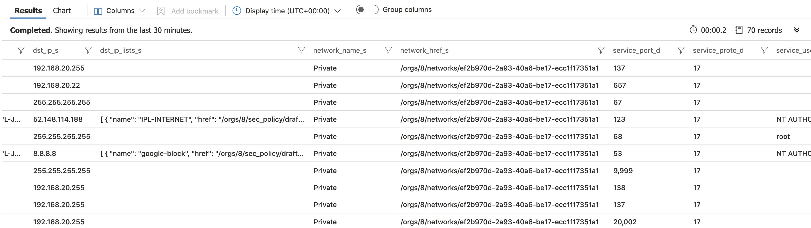
Verification
Verify on Azure Sentinel Custom Logs:
Traffic data sample.

Slide 39
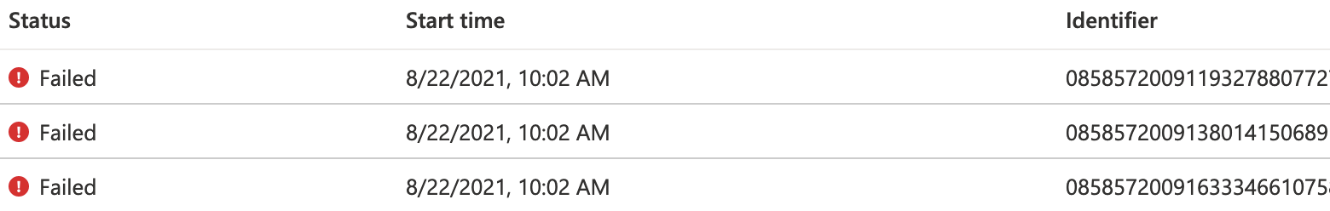
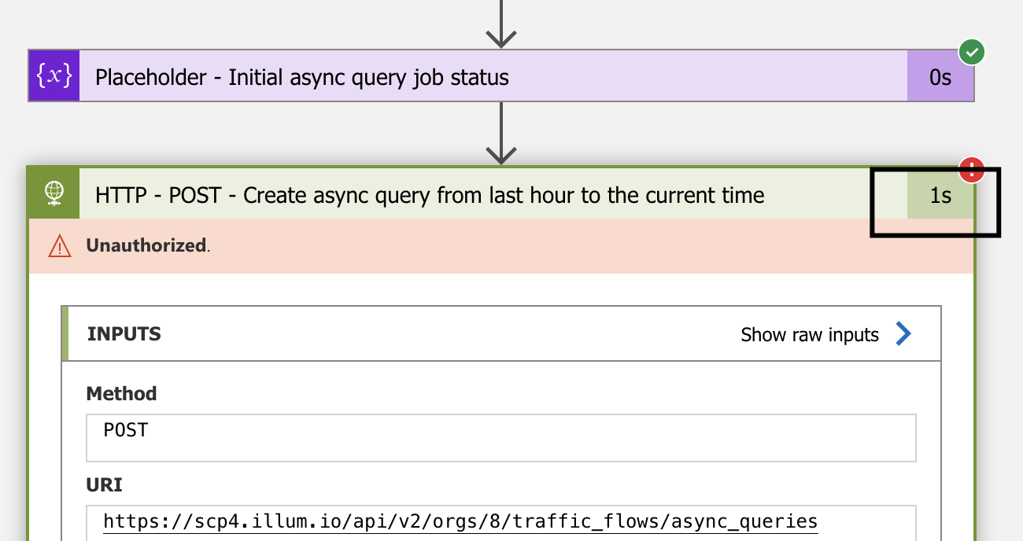
If there is error
Should there is error during execution, you can always check back to the apps logs and able to find out the error in the history.

Slide 40
Info

Slide 41
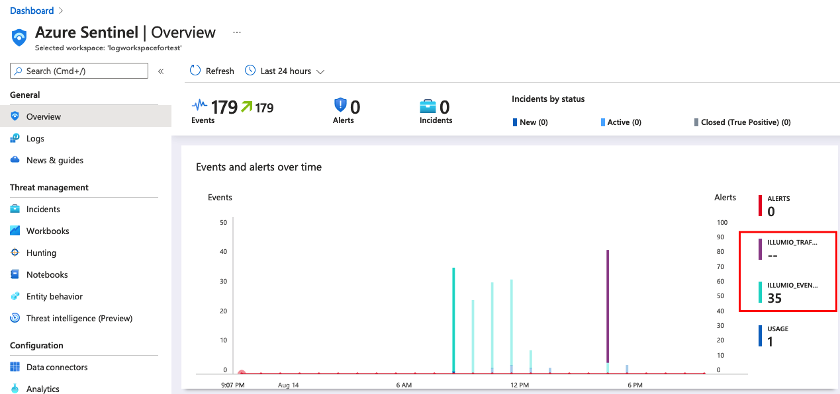
Basic Dashboard View on Azure Sentinel
Default Dashboard

Slide 42
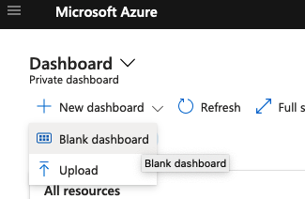
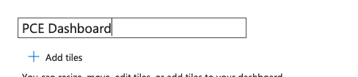
Custom Dashboard
Custom Dashboard

Slide 43
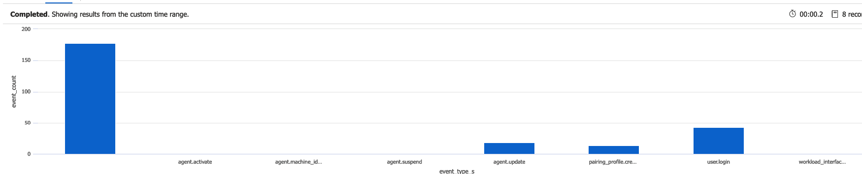
Sample Queries
Sample 1:
illumio_events_CL
| where event_type_s == "agent.activate”
Sample 2:
illumio_events_CL
| where event_type_s == "agent.update" and severity_s != "info"
| summarize event_count=count() by created_by_agent_hostname_s
| render timechart
Sample 3:
illumio_events_CL
| summarize event_count=count() by event_type_s
| sort by event_type_s asc
| render columnchart

Slide 44
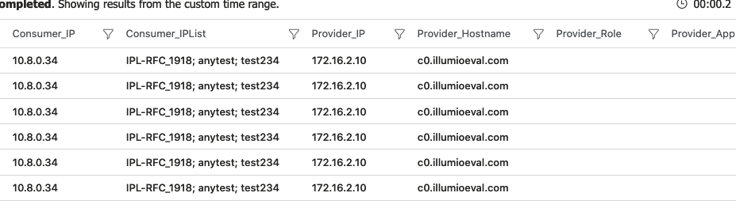
Traffic Data Query Sample 1
Consumer as IPList
illumio_traffic_CL // consumer as iplist
| project Flows = split(Message, ",")
| where isnotempty(Flows[1]) and Flows[1] != "Consumer IPList"
| mv-expand Consumer_IP=Flows[0], Consumer_IPList=Flows[1], Provider_IP=Flows[11], Provider_Hostname=Flows[14], Provider_Role=Flows[15], Provider_App=Flows[16], Provider_Env=Flows[17], Provider_Loc=Flows[18], Provider_FQDN=Flows[19], Transmission=Flows[20], Port=Flows[21], Protocol=Flows[22], Num_Flows=Flows[26], Connection_State=Flows[27], Reported_Policy_Decision=Flows[28], Reported_by=Flows[29], First_Detected=Flows[30], Last_Detected=Flows[31]

Slide 45
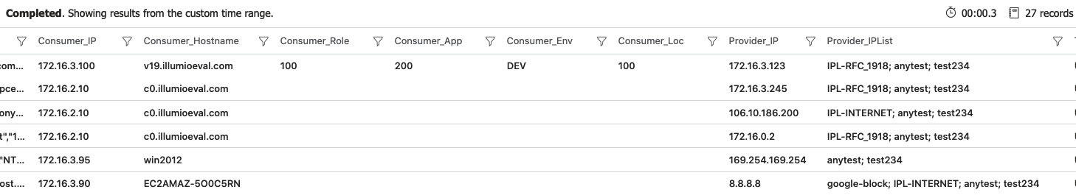
Traffic Data Query Sample 2
Provider as IPList
illumio_traffic_CL // provider as iplist
| project Flows = split(Message, ",")
| where isnotempty(Flows[12]) and Flows[12] != "Provider IPList"
| mv-expand Consumer_IP=Flows[0], Consumer_Hostname=Flows[3], Consumer_Role=Flows[4], Consumer_App=Flows[5], Consumer_Env=Flows[6], Consumer_Loc=Flows[7], Provider_IP=Flows[11], Provider_IPList=Flows[12], Transmission=Flows[20], Port=Flows[21], Protocol=Flows[22], Num_Flows=Flows[26], Connection_State=Flows[27], Reported_Policy_Decision=Flows[28], Reported_by=Flows[29], First_Detected=Flows[30], Last_Detected=Flows[31]

Slide 46
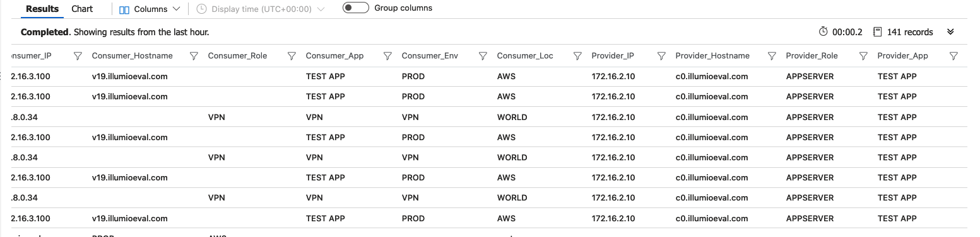
Traffic Data Query Sample 3
Both Groups
illumio_traffic_CL // group to group
| project Flows = split(Message, ",")
| where isempty(Flows[1]) and isempty(Flows[12])
| mv-expand Consumer_IP=Flows[0], Consumer_Hostname=Flows[3], Consumer_Role=Flows[4], Consumer_App=Flows[5], Consumer_Env=Flows[6], Consumer_Loc=Flows[7], Provider_IP=Flows[11], Provider_Hostname=Flows[14], Provider_Role=Flows[15], Provider_App=Flows[16], Provider_Env=Flows[17], Provider_Loc=Flows[18], Provider_FQDN=Flows[19], Transmission=Flows[20], Port=Flows[21], Protocol=Flows[22], Num_Flows=Flows[26], Connection_State=Flows[27], Reported_Policy_Decision=Flows[28], Reported_by=Flows[29], First_Detected=Flows[30], Last_Detected=Flows[31]

Slide 47
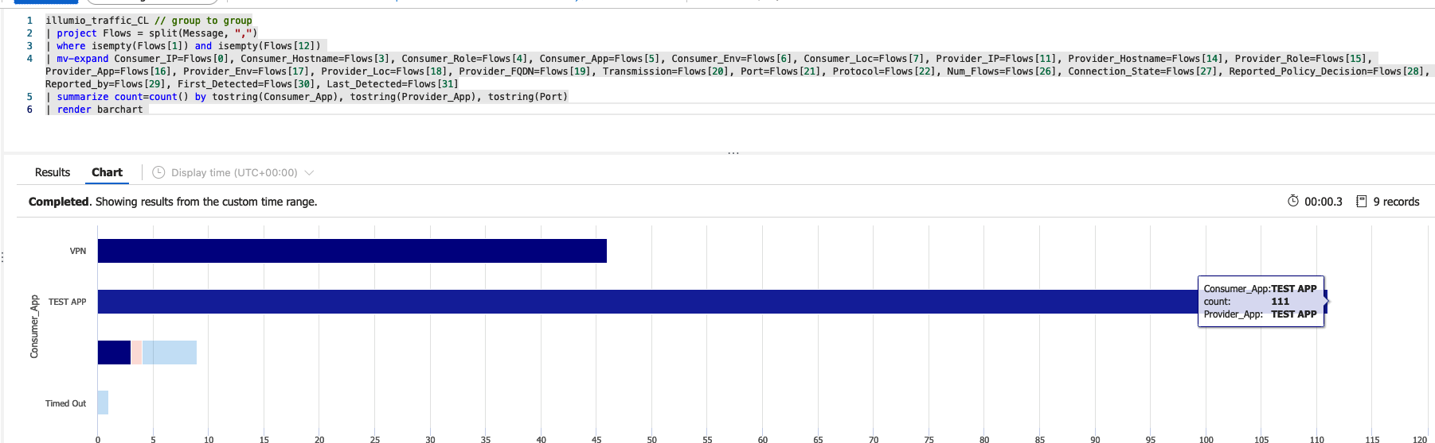
Traffic Data Query Sample 3
illumio_traffic_CL // group to group
| project Flows = split(Message, ",")
| where isempty(Flows[1]) and isempty(Flows[12])
| mv-expand Consumer_IP=Flows[0], Consumer_Hostname=Flows[3], Consumer_Role=Flows[4], Consumer_App=Flows[5], Consumer_Env=Flows[6], Consumer_Loc=Flows[7], Provider_IP=Flows[11], Provider_Hostname=Flows[14], Provider_Role=Flows[15], Provider_App=Flows[16], Provider_Env=Flows[17], Provider_Loc=Flows[18], Provider_FQDN=Flows[19], Transmission=Flows[20], Port=Flows[21], Protocol=Flows[22], Num_Flows=Flows[26], Connection_State=Flows[27], Reported_Policy_Decision=Flows[28], Reported_by=Flows[29], First_Detected=Flows[30], Last_Detected=Flows[31]

Slide 48
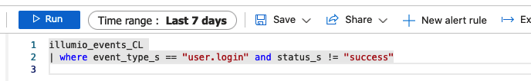
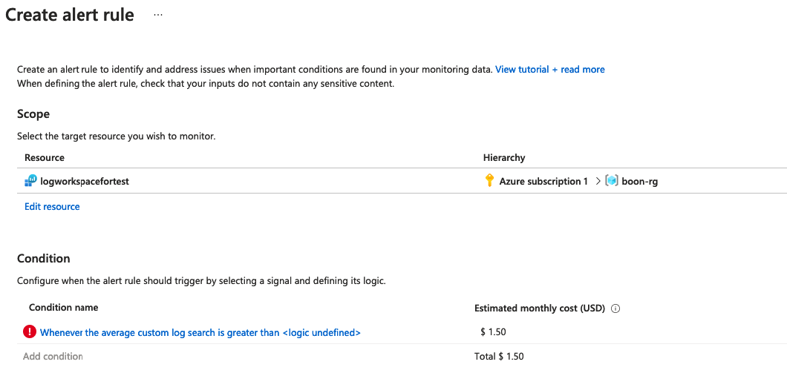

Alert

Slide 49
Thank you

